Slide 1
Oligopoly Price
An oligopoly market exists when barriers to entry result in a few mutually dependent companies controlling a substantial portion of a market.

Slide 2
Pricing models in Oligopoly
Three well-defined pricing models exist
1. Kinked demand
2. Collusive pricing
3. Price leadership

Slide 3
KINKED-DEMAND CURVE IN OLIGOPOLY
A demand curve with two distinct segments which have different elasticities that join to form a corner or kink.
The primary use of the kinked-demand curve is to explain price rigidity in oligopoly.

Slide 4
Cont..
The two segments are: (1) a relatively more elastic segment for price increases and (2) a relatively less elastic segment for price decreases.
The relative elasticities of these two segments is based on the interdependent decision-making of oligopolistic firms.

Slide 5
Cont..
An oligopolist faces a downward sloping demand curve but the elasticity may depend on the reaction of rivals to changes in price and output.
Assuming that firms are attempting to maintain a high level of profits and their market share it may be the case that:

Slide 6
Cont.
(a) rivals will not follow a price increase by one firm - therefore demand will be relatively elastic and a rise in price would lead to a fall in the total revenue of the firm.
(b) rivals are more likely to match a price fall by one firm to avoid a loss of market share. If this happens demand will be more inelastic and a fall in price will also lead to a fall in total revenue.

Slide 7
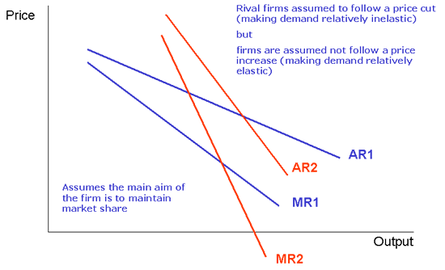
Fig:A

Slide 8
Cont..
The kink in the demand curve at price P and output Q means that there is a discontinuity in the firm's marginal revenue curve.
If we assume that the marginal cost
curve is cutting the MR curve then the firm is maximising profits at this point.

Slide 9
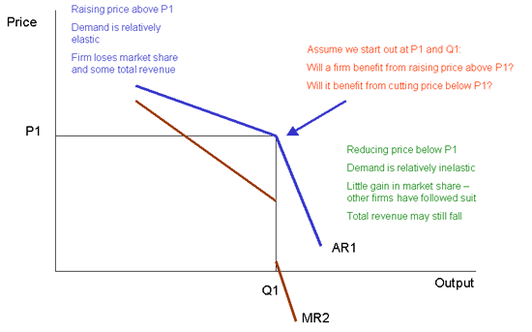
Fig:B

Slide 10
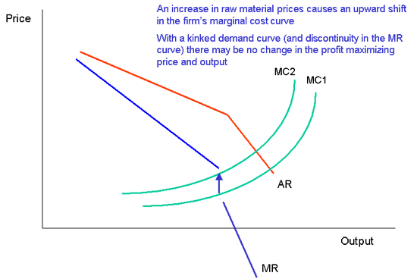
Fig:C

Slide 11
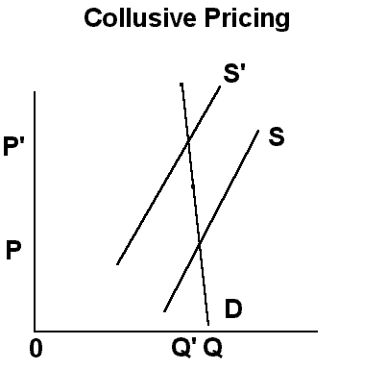
Collusive pricing

Slide 12
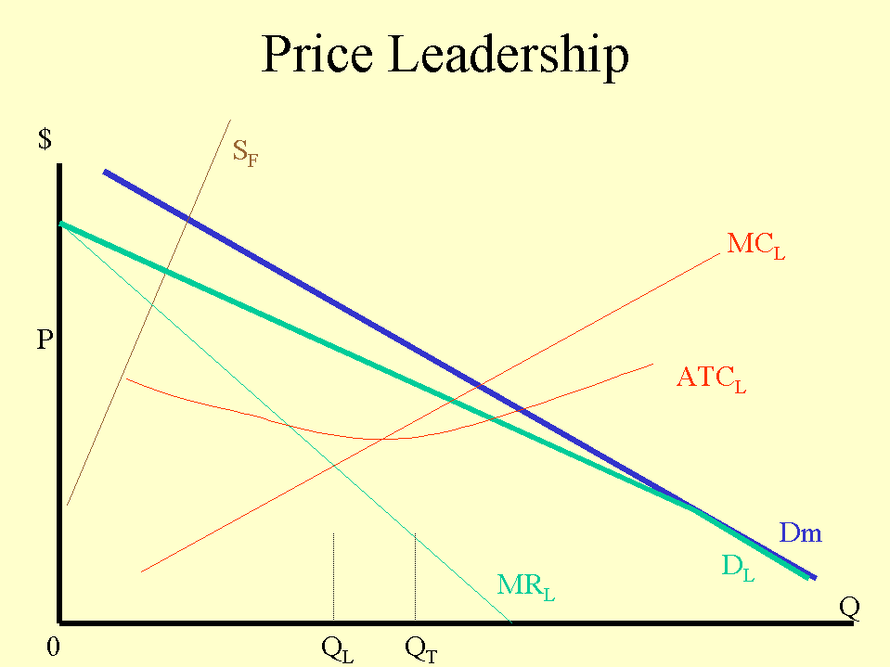
Price leadership

Slide 13
Cont..
Taking into account the total supply of the followers, acting like a monopoly, the leader sets its marginal cost equal to its MR and determine the price according to the residual market demand, DL.
The followers take the price determined by the leader as given and act like competitive firms.
The sum of the outputs produced by the leader and the followers would be the equilibrium quantity at the price set by the leader.

Slide 14
Key Features
Price leadership occurs when a dominant firm sets the price for goods or services in the market, typically in an oligopolistic market with homogeneous products. Customers have limited choices, often opting for the lowest price.
Three types of price leadership exist: barometric, where the firm with the best market information sets the price; collusive, where firms collaborate to set prices collectively; and dominant, where the leading firm unilaterally sets the price.
Price leadership is often used by a strong firm to establish its presence in the market. Following price leadership and avoiding price wars can benefit smaller firms.

